Slide 1
Predicting Insurance Charges Using Machine Learning Models

Slide 2
Outline
Executive Summary
Introduction
Methodology
Results
Conclusion

Slide 3
Executive Summary
Summary Of Methodologies
Data Collection: Accessed Health Insurance Data via Kaggle
Data Cleaning & Preparation:
Cleaned and formatted the data.
Conducted exploratory data analysis.
Conducted feature engineering
Interactive Visualizations: Created visual comparisons between patient health features and insurance charges.
Model Building & Evaluation:
Implemented Decision Trees, and Random Forest, XG Boost.
Tuned hyperparameters with GridSearchCV.
Evaluated models using test data accuracy.

Slide 4
Executive Summary
5. Summary of Results
Data Insights: · Identified key factors influencing medical insurance charges. · Visualized how age, BMI, smoking status, and region affects insurance cost trends.
Model Performance: · Decision Tree, Random Forest and XG Boost models achieved strong predictive accuracy. · XG Boost Fine Tuned performed best, capturing non-linear relationships between features and charges.
Key Findings: · Smoking status(79%) has the greatest impact on insurance costs. · Older individuals and smokers tend to pay significantly higher premiums. · The XG Boost model proved the most effective for predicting charges.

Slide 5
Introduction
Project Background And Context
With healthcare costs rising, it’s important for insurance companies to predict medical charges accurately based on individual factors. This project looks at how factors like age, gender, BMI, smoking habits, and region affect insurance costs. By using data analysis and machine learning, we aim to find the most important factors that influence medical expenses and create a system that can estimate charges more fairly and efficiently.
Problem Statement
What key factors most influence medical insurance costs?
How accurately can we predict insurance charges based on personal and lifestyle factors?
Which machine learning model provides the most reliable prediction of insurance costs?

Slide 6
Methodology

Slide 7
Data Collection
Step 1: Data Source (Kaggle Dataset)
Store Data Locally
Convert to DataFrame
Load For Analysis
Fetch
Data
Store Data Locally
Store Data Locally
Step 2: Data Wrangling
Encode Categorical Features
Normalize Numerical Features
Handle Missing Values
Step 3: Data Integration
Combine Cleaned Data
Verify Consistency
Final Dataset Ready

Slide 8
Data Wrangling
Verify Data
Accuracy
(consistency checks)
Identify Missing
Values (pandas.isnull)
Encoded Features Using One-hot Encoding
Verify Data
Accuracy
(consistency checks)
Impute/Remove Missing Data (fillna/dropna)
Scaling Features Using Standard Scaler
Data Cleaning Summary
Missing Values: 0
Duplicate Values: 1
Dropped Values: 1
Convert Data Types (pd.BMI, astype)
Feature Engineering (create new columns)
Check for Duplicates (pd.duplicated, drop)
Verify Correlation Between Values

Slide 9
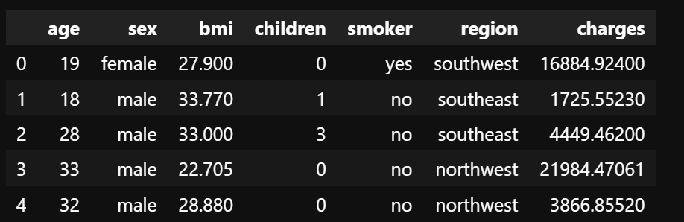
Dataset Preview

Slide 10
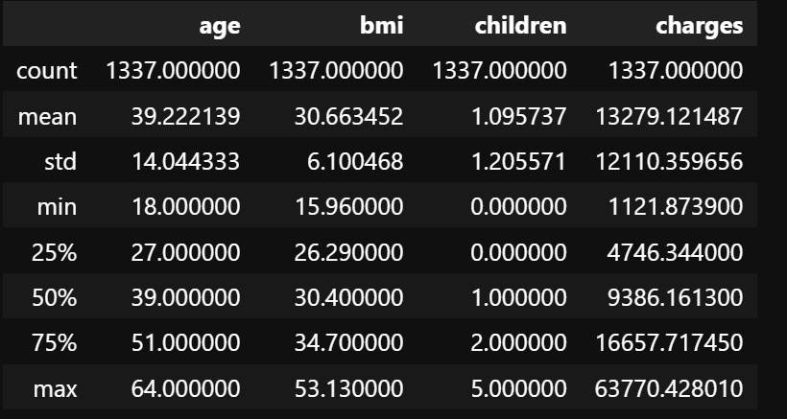
Statistical Description Of The Dataset

Slide 11
Exploratory Data Analysis

Slide 12
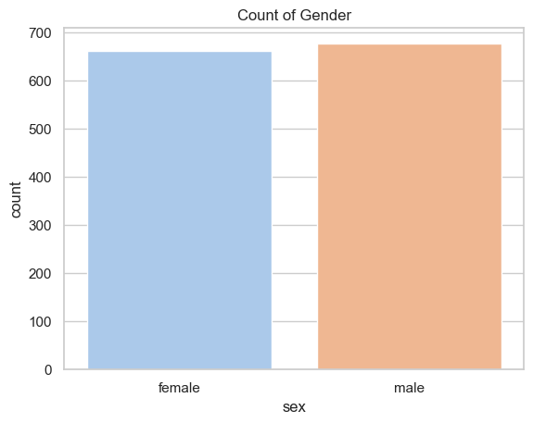
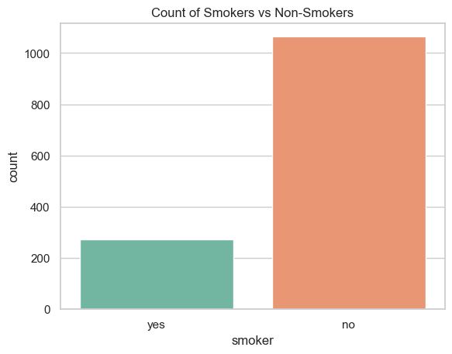
Population Breakdown by Children and Smoking Habits

Slide 13
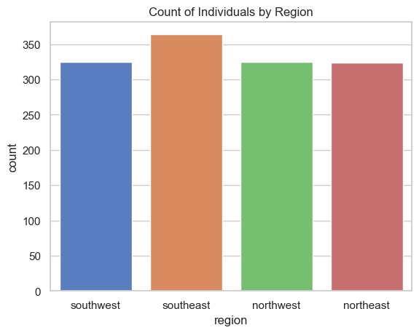
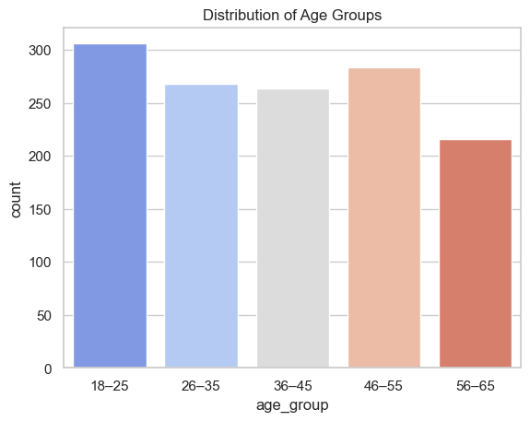
Population Breakdown by Region and Age

Slide 14
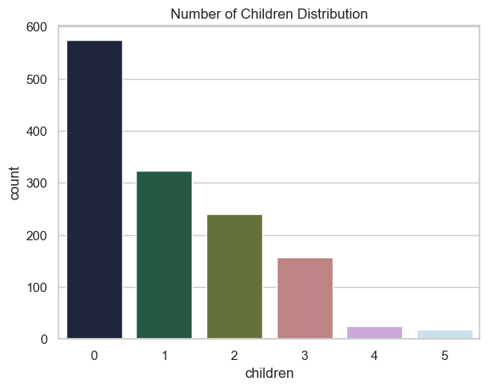
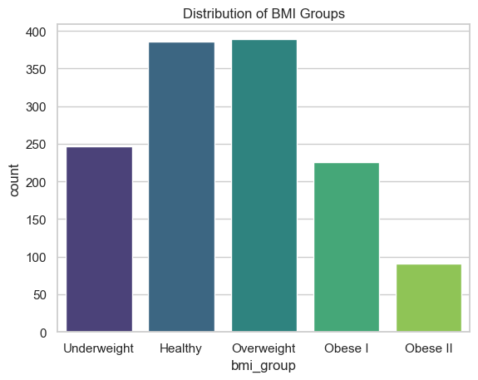
Population Breakdown by BMI and Family Size

Slide 15
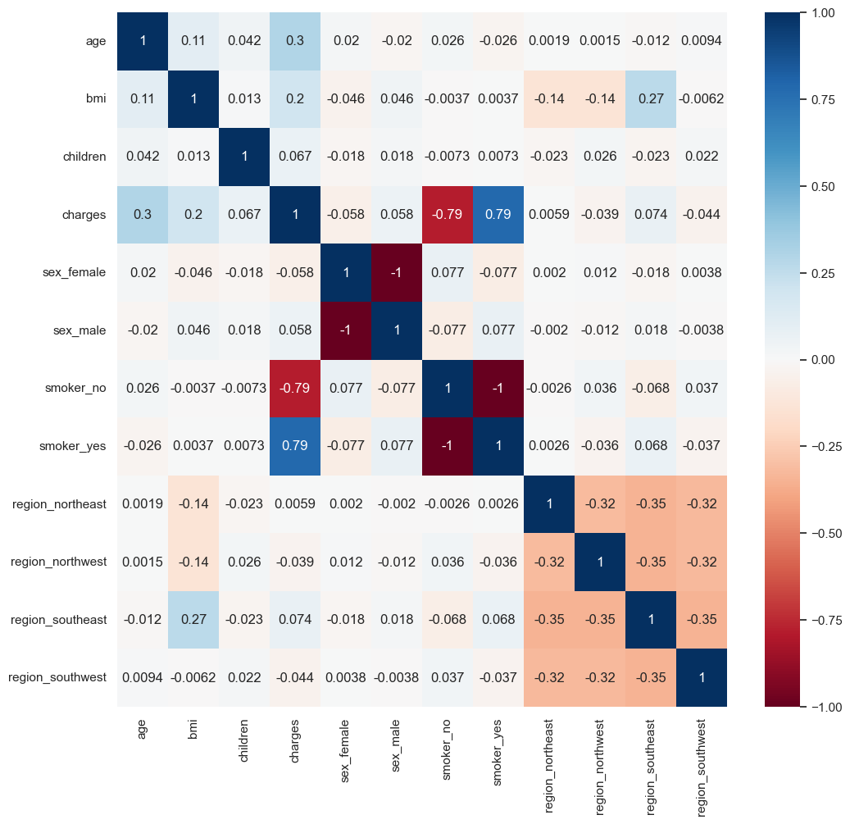
Data Visualization

Slide 16
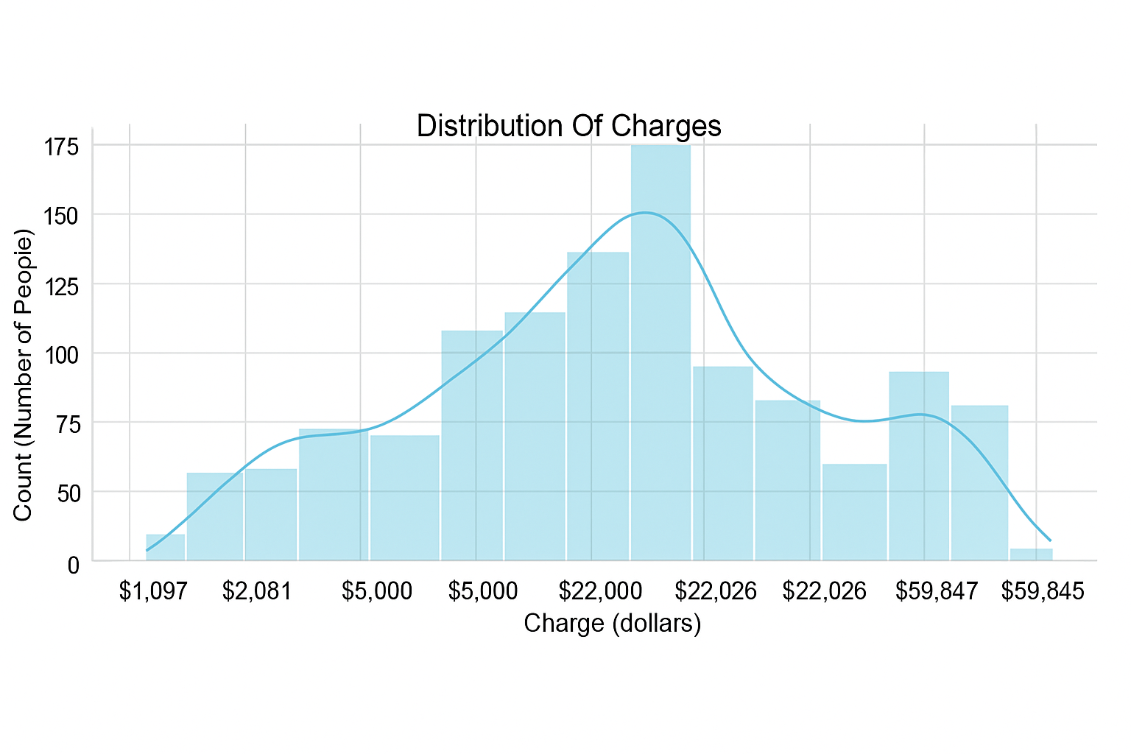
Distribution Of Charges To Patients

Slide 17
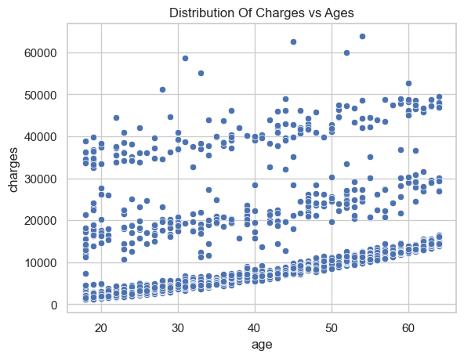
Relationship Between Charges Vs Ages
INSIGHT
This visualization indicates that there is a mild positive correlation between age and charges. This tells the story that age does not really influence the

Slide 18
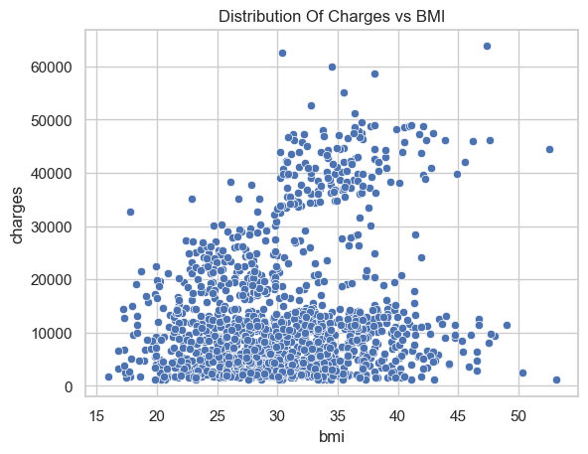
Relationship Between Charges Vs BMI
INSIGHT
This indicates that there’s a mild positive trend, but scattered. This visualization indicates that a higher BMI can sometimes lead to higher insurance charges.

Slide 19
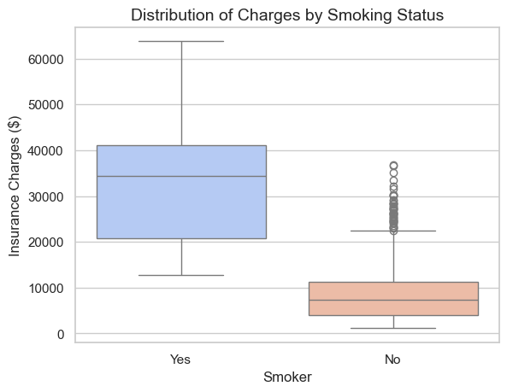
Relationship Between Charges Vs Smoking
INSIGHT
This visualization indicates a strong relationship between smoking status and insurance charges. Hence, an individual smoking significantly affects their charges.

Slide 20
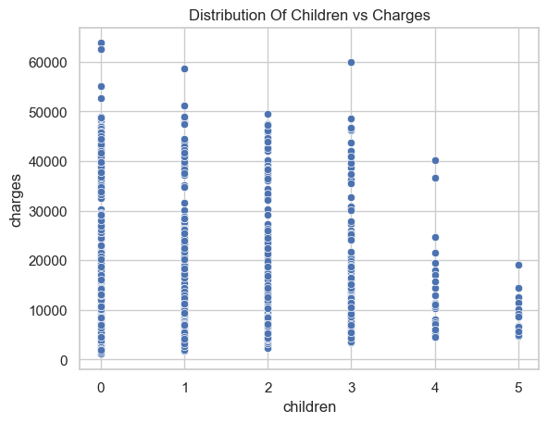
Relationship Between Charges Vs Children
INSIGHT
This visualization indicates no strong relationship between the number of children and insurance charges. Hence number of children doesn’t significantly affect charges.

Slide 21
Model Development

Slide 22
Predictive Analysis (Flowchart)
Data Preprocessing
Best Performing Model
Model
Selection
Improvement
Iterations
Hyperparameter
Tuning
Model
Evaluation

Slide 23
Model Development (Regression)
Model Selection: - Implemented and compared multiple regression algorithms, Decision Tree, and Random Forest and XG Boost to predict insurance charges.
Hyperparameter Tuning: - Applied GridSearchCV to find the best parameter combinations, improving each model’s accuracy and performance.
Model Evaluation: - Models were evaluated using R² and Mean Squared Error (MSE) to measure predictive strength and reliability.
Improvement Iterations: - Adjusted model parameters and re-evaluated results to enhance predictive precision.
Best Model: - The XG Boost Model achieved the highest accuracy and lowest error, making it the optimal model for predicting insurance charges.

Slide 24
Results

Slide 25
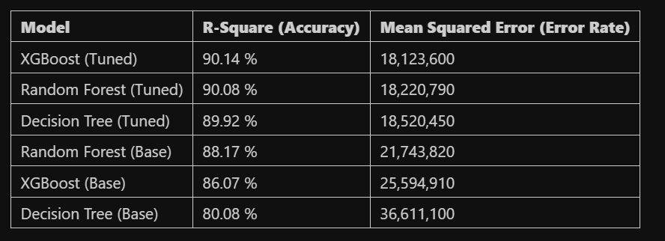
Model Evaluations

Slide 26
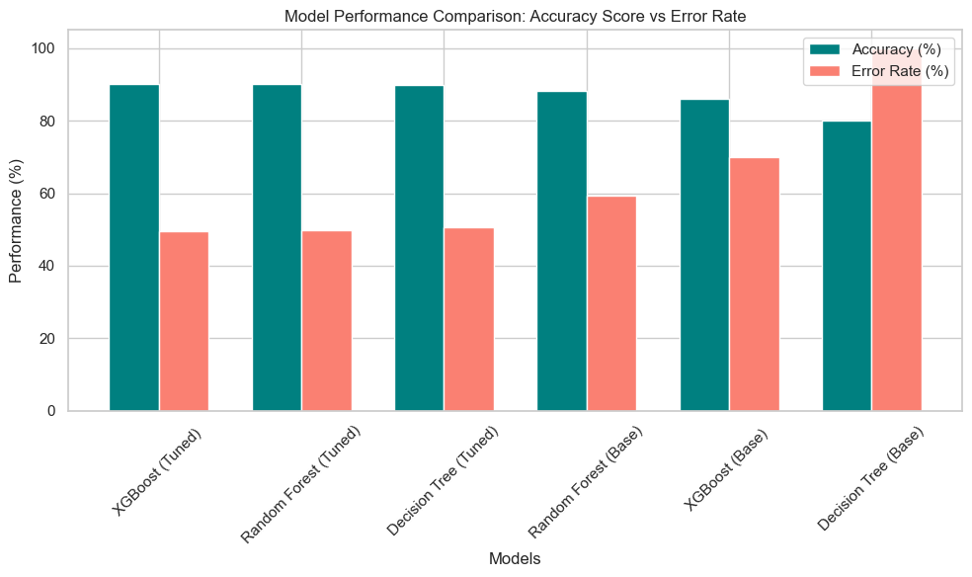
Distribution Of Model Performance

Slide 27
Model Deployment

Slide 28
Model Deployment and Application Development
The model was deployed using Gradio to create an interactive web interface.Three versions of the application were developed to enhance functionality and performance:
Version 1: Basic Gradio interface for user input.
No individual name input
No database connection
Version 2: Added a database to store user records.
No live updates to the database
Version 3: Integrated live database updates with user information.
Fully functional and complete version

Slide 29
TESTING

Slide 30
Conclusion

Slide 31
Conclusion
Point 1: Our analysis showed that smoking is the biggest factor affecting insurance costs. Smokers almost always pay much more than non-smokers, showing how lifestyle choices can impact healthcare expenses.
Point 2: Age and BMI both have a mild positive relationship with insurance charges older people and those with higher BMI usually face higher costs, which reflects greater health risks.
Point 3: There wasn’t a strong link between the number of children and insurance charges, which suggests that family size doesn’t affect medical expenses as much as health and lifestyle factors.

Slide 32
Conclusion
In conclusion, our analysis and visualizations show the main factors that affect medical insurance costs. Age, BMI, and smoking habits all influence how much people pay. These findings can help insurance companies set fairer prices and also encourage people to make healthier choices to reduce their medical expenses.”

Slide 33
QUESTIONS?

